Slide 1
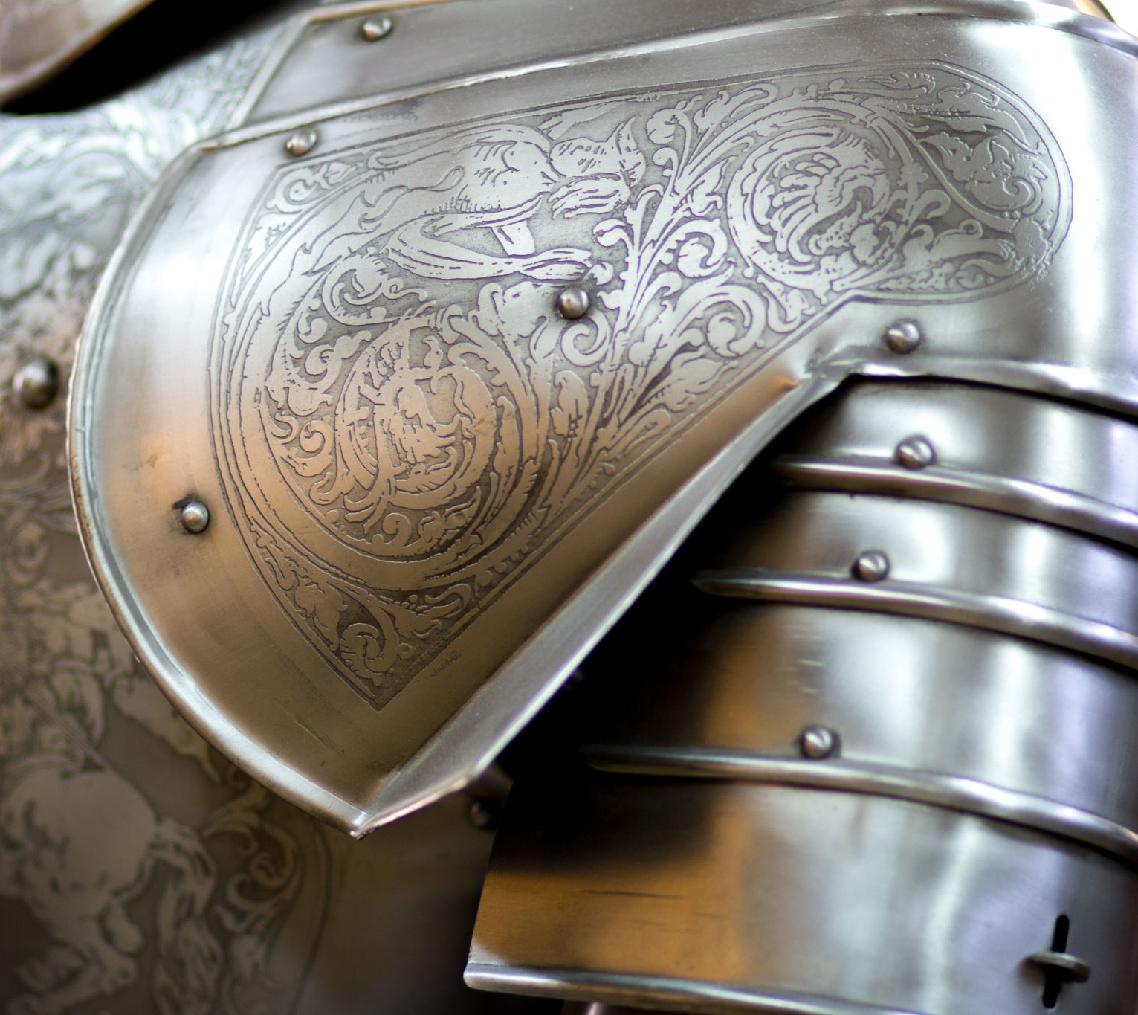

The Medieval Era
Assist. Prof. Dr. Pelin GÖLCÜK MİRZA
ELIT322 Medieval Literature
Week-2&3

Slide 2
410
Roman Withdrawal from Britain
In 410, the Roman Empire withdrew from Britain. This marked the beginning of a new era in British history, as the native Britons faced increasing pressure from the incoming Anglo-Saxon settlers.
449
Arrival of the Angles, Saxons, and Jutes
In 449, the Angles, Saxons, and Jutes, three Germanic tribes, began to arrive in Britain. They came from present-day Denmark and Germany, seeking new lands to settle.
597
Christian Conversion
In 597, Pope Gregory I sent a mission to England led by Augustine, who later became the first Archbishop of Canterbury. This marked the beginning of the Christian conversion of the Anglo-Saxon kingdoms.
793
Viking Raids
In 793, Viking raiders from Scandinavia launched a devastating attack on the monastery of Lindisfarne. The Vikings posed a significant threat to the existing Anglo-Saxon kingdoms and caused widespread disruption and upheaval.
871-899
Reign of Alfred the Great
From 871 to 899, Alfred the Great ruled as the King of Wessex. He successfully defended his kingdom against Viking invasions and laid the foundation for the eventual unification of England under Anglo-Saxon rule. Alfred is also remembered for his efforts to promote education and literacy, commissioning the translation of various texts into Old English.
1066
Norman Conquest
In 1066, William the Conqueror, Duke of Normandy, invaded England and defeated the Anglo-Saxon king, Harold II, in the Battle of Hastings..

Slide 3
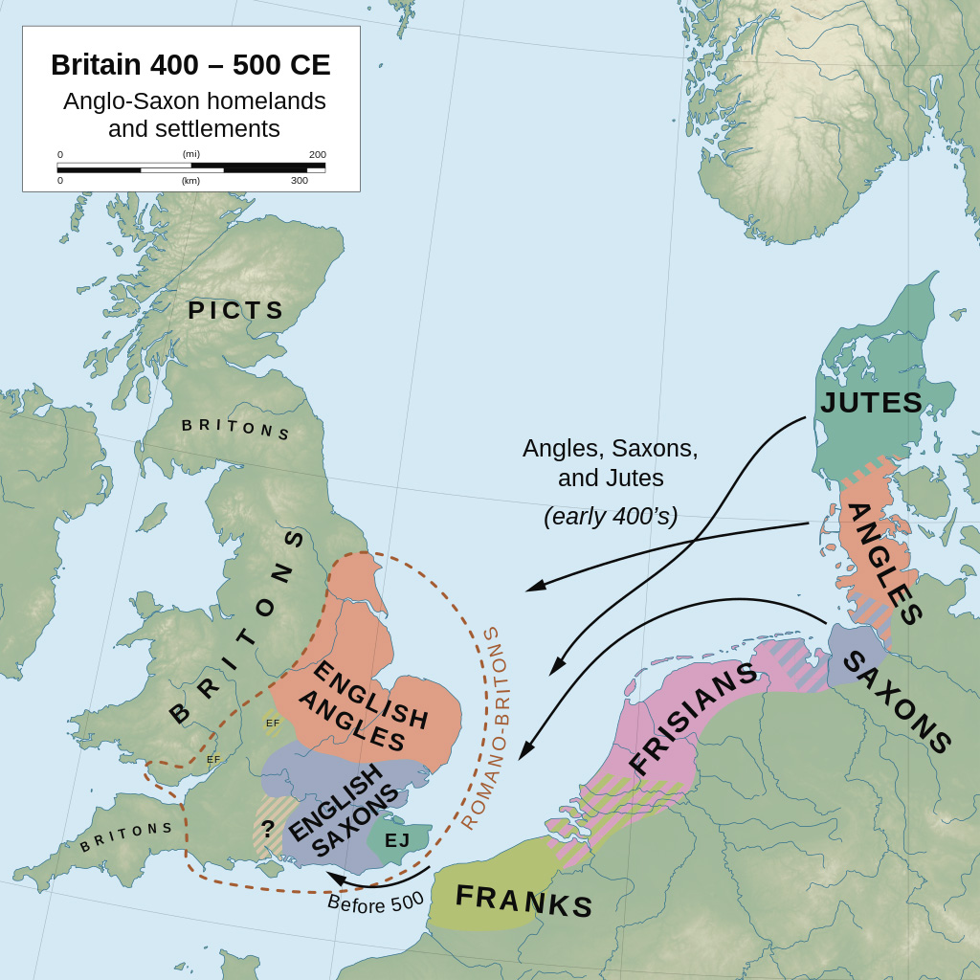

Slide 4
INTRODUCTION
Assist. Prof.Dr. Pelin GÖLCÜK MİRZA
The Medieval Period, also known as the Middle Ages, spans roughly from the 5th to the late 15th century. For Britain, as Behtash and Toroujeni (2017) put it, “the period began and ended with the arrival of two conquerors including the conquest of Normans in 1066, and the printing press in 1476” (p. 143). This era was marked by the fall of the Roman Empire, the rise of feudalism, and the dominance of the Christian Church. Literature during this time reflects the complex socio-political landscape, with themes of chivalry, religion, and courtly love.
Key Events:
- The Fall of Rome (476 AD)
- The Norman Conquest (1066)
- The Black Death (1347-1351)
- The Printing Press (1476)

Slide 5
The Norman Conquest and Its Impacts
Assist. Prof.Dr. Pelin GÖLCÜK MİRZA
In 1066, William the Conqueror, a descendant of the Vikings, led the Norman Conquest of England. This event had profound cultural, linguistic, and social impacts:
- French became the language of the ruling class, influencing English vocabulary and grammar.
- Feudalism was established, restructuring the societal hierarchy.
- The Domesday Book was created, documenting landholdings and resources, reflecting the new power dynamics.
The Conquest also influenced literature, as themes of power, loyalty, and conquest became prominent.

Slide 6
Assist. Prof.Dr. Pelin GÖLCÜK MİRZA
Medieval English Literature is divided into two ;
1-Old English Literature (epic, chronicles, lyrics, didactic prose)
2-Middle English Literature (Satirical Alliterative Poems, Romance, Dream Vision, debate poetry, Morality/Miracle Plays)

Slide 7
Old English literature (c. 450–1066)
Assist. Prof.Dr. Pelin GÖLCÜK MİRZA
Old English literature, or Anglo-Saxon literature, encompasses the surviving literature written in Old English in Anglo-Saxon England, in the period after the settlement of the Saxons and other Germanic tribes in England (Jutes and the Angles) c. 450, after the withdrawal of the Romans, and "ending soon after the Norman Conquest" in 1066. These works include genres such as epic poetry, hagiography, sermons, Bible translations, legal works, chronicles and riddles. In all there are about 400 surviving manuscripts from the period.

Slide 8
Old English literature (c. 450–1066)
Assist. Prof.Dr. Pelin GÖLCÜK MİRZA
According to Bede (Ecclesiastical History of English People),
Cædmon's Hymn, a poem from the 7th century, is considered the oldest surviving poem in English.By the mid-12th century, some of the last examples of Old English poetry were written, such as The Soul's Address to the Body (1150-1175), which is found in a manuscript from Worcester Cathedral.
Even though this poem is mostly in Old English, it includes only one word of Latin origin.The poem uses Old English grammar and a type of alliteration (where the same sounds repeat), but it shows signs of decline in quality.Because this form of Old English was deteriorating, early scholars referred to it as "Semi-Saxon" (a mix of Old English and something more modern).

Slide 9
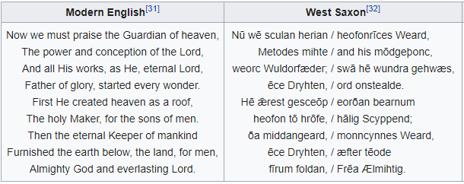
Old English literature (c. 450–1066)
Assist. Prof.Dr. Pelin GÖLCÜK MİRZA
Nearly all Anglo-Saxon authors are anonymous: twelve are known by name from medieval sources, but only four of those are known by their vernacular works with any certainty: Cædmon, Bede, Alfred the Great, and Cynewulf.

Slide 10
Old English Period
Assist. Prof.Dr. Pelin GÖLCÜK MİRZA
This period was dominated by epic poems, in particular.
These poems celebrate the deeds and achievements of a here. The concept of honor and loyalty is recurrently emphasized.
Those works relied on oral tradition and there were some wandering composers such as Scop, Bard, or Gleeman and they were illiterate.
Musicality was a significant aspect of those works. They composed their poems in alliterative verses.
Transition from paganism to christianity.

Slide 11
Cont’d..
Assist. Prof.Dr. Pelin GÖLCÜK MİRZA
In literature, alliteration is the repetition of identical initial consonant sounds in successive or closely associated syllables within a group of words, even those spelled differently. As a method of linking words for effect, alliteration is also called head rhyme or initial rhyme. For example, "humble house," or "potential power play."A familiar example is "Peter Piper picked a peck of pickled peppers".

Slide 12
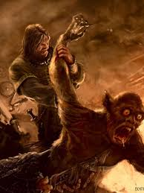
Assist. Prof.Dr. Pelin GÖLCÜK MİRZA
Beowulf is the most famous work in Old English, and has achieved national epic status in England, despite being set in Scandinavia. It reflects Anglo-Saxon patriarchal society. It includes Celtic mythology and Christian elements.
https://www.youtube.com/watch?v=CH-_GwoO4xI

Slide 13
Cont’d..
Assist. Prof.Dr. Pelin GÖLCÜK MİRZA
It is an Old English epic poem in the tradition of Germanic heroic legend consisting of 3,182 alliterative lines. It is one of the most important and most often translated works of Old English literature. The date of composition is a matter of contention among scholars; the only certain dating is for the manuscript, which was produced between 975 and 1025.

Slide 14
Introduction to Middle English
Assist. Prof.Dr. Pelin GÖLCÜK MİRZA
The English spoken after the Normans came is known as Middle English. This form of English lasted until the 1470s, when the Chancery Standard (late Middle English), a London-based form of English, became widespread.
Geoffrey Chaucer (1343 – 1400), author of The Canterbury Tales, was a significant figure in the development of the legitimacy of vernacular Middle English at a time when the dominant literary languages in England were still French and Latin. The invention of the printing press by Johannes Gutenberg in 1439 also helped to standardise the language, as did the King James Bible (1611), and the Great Vowel Shift.

Slide 15
Middle English literature (1066–1500)
Assist. Prof.Dr. Pelin GÖLCÜK MİRZA
After the Norman conquest of England in 1066, the written form of the Anglo-Saxon language became less common. Under the influence of the new aristocracy, French became the standard language of courts, parliament, and nobles. As the invaders integrated, their language and literature mingled with that of the natives, and the Norman dialects of the ruling classes became Anglo-Norman. From then until the 12th century, Anglo-Saxon underwent a gradual transition into Middle English.

Slide 16
Middle English literature (1066–1500)
Assist. Prof.Dr. Pelin GÖLCÜK MİRZA
In this period religious literature continued to enjoy popularity and Hagiographies were written, adapted and translated: for example, The Life of Saint Audrey, Eadmer's (c. 1060 – c. 1126).
At the end of the 12th century, Layamon in Brut/Layamon’s Brut adapted the Norman-French of Wace to produce the first English-language work to present the legends of King Arthur and the Knights of the Round Table. It was also the first historiography written in English since the Anglo-Saxon Chronicle.
Middle English Bible translations, notably Wycliffe's Bible, helped to establish English as a literary language.

Slide 17
Middle English literature (1066–1500)
Assist. Prof.Dr. Pelin GÖLCÜK MİRZA
Another literary genre, that of Romances, appears in English from the 13th century, with King Horn and Havelock the Dane, based on Anglo-Norman originals such as the Romance of Horn (c. 1170),[30] but it was in the 14th century that major writers in English first appeared. These were William Langland, Geoffrey Chaucer and the so-called Pearl Poet, whose most famous work is Sir Gawain and the Green Knight.
Sir Gawain and the Green Knight is a late 14th-century Middle English alliterative romance. It is one of the better-known Arthurian stories of an established type known as the "beheading game". Developing from Welsh, Irish and English tradition, Sir Gawain highlights the importance of honour and chivalry.

Slide 18
Middle English literature (1066–1500)
Assist. Prof.Dr. Pelin GÖLCÜK MİRZA
Middle English lasted until the 1470s, when the Chancery Standard, a London-based form of English, became widespread and the printing press started to standardise the language. Chaucer is best known today for The Canterbury Tales. This is a collection of stories written in Middle English (mostly in verse although some are in prose), that are presented as part of a story-telling contest by a group of pilgrims as they travel together from Southwark to the shrine of St Thomas Becket at Canterbury Cathedral.

Slide 19
LITERACY IN THE MEDIEVAL ENGLAND
Assist. Prof.Dr. Pelin GÖLCÜK MİRZA
Beacuse of the scholastic doctrine dominating the age, education, learning and thus literacy in the Medieval England is associated with clergy and Latin language.
The language of the court and judicial system was French.
English for the peasants

Slide 20
Literacy in Medieval England
Assist. Prof.Dr. Pelin GÖLCÜK MİRZA
Literacy during the medieval period was largely confined to the clergy and the elite. The Church played a central role in education, and Latin was the language of scholarship:
- Clergy and Latin: The clergy were the primary literate class, responsible for copying manuscripts and preserving knowledge.
- French and the Nobility: The Norman influence meant that French was the language of the court and legal documents.
- English for the Commoners: English was spoken by the lower classes, and over time, it evolved to become the dominant language of the country.
Medieval literature often reflects these linguistic divides, with works like The Canterbury Tales mirroring the diverse voices of the time.

Slide 21
The Crown and the Church
Assist. Prof.Dr. Pelin GÖLCÜK MİRZA
The relationship between Christianity and Kingdom identified the patterns of Christendom practices. By the year 1200, most of England had been Christian territory for half a millenium. Chritian beliefs and Christian manners shaped all the institutions and defined their identity. Everyone was subscribed to very well known during the middle ages that a king desire was always to protect and improve the aims and staff of the church (Horrox,293). However, this created a lot of conflicts and crises for the Church and the Crown.

Slide 22
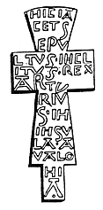
The Church
Provided guidance through well known precepts..
  Seven Deadly Sins
    Pride
    Greed
    Wrath
    Envy
    Gluttony
    Sloth
    Lust

Slide 23
The Crown and the Church
Assist. Prof.Dr. Pelin GÖLCÜK MİRZA
The relationship between the monarchy and the Church was a defining feature of medieval society. The Church held immense power, often clashing with kings over authority and governance:
- The Investiture Controversy: A significant conflict over the appointment of church officials.
- The Crusades: Religious wars sanctioned by the Church, supported by monarchs.
- **The Magna Carta (1215)**: A document limiting the king's power, influenced by the Church's desire to protect its rights.
These conflicts are reflected in medieval literature, where the Church and its representatives often play crucial roles.

Slide 24
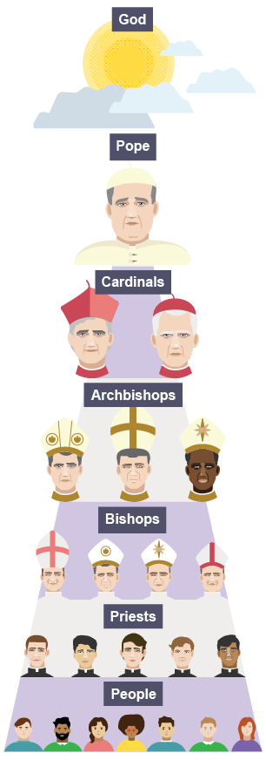

Slide 25
Papacy, the universal churchs
Assist. Prof.Dr. Pelin GÖLCÜK MİRZA
Empires and kings were supposed to be in the church, not beside or above it (Ladner 406)
Brian Tierney also sums the conflict between the pope and the king as desire to get power to speak the law (jurisdiction). The church claimed personal or subject matter jurisdictipn over clerics, pilgrims, students, the poor, heretics, Jews, Muslims about ecclesiastical property, polity, patronage, sex, marriage, family life, education, and so on. The Popes began considering the kings less and less as functionaries of the church. They made it clear that for them rulers were simply the leaders of the peoples and holders of territories. (Logan 409).

Slide 26
After plague
Assist. Prof.Dr. Pelin GÖLCÜK MİRZA
* The power of the Church was severely weakened by the plague. As the disease diminished the population, including many members of the clergy, people began to question the Church's ability to protect them and its role as a moral and spiritual authority.
The mass deaths led to a crisis of faith among the populace
As the Church's authority weakened, secular rulers, including kings, seized the opportunity to assert greater control over their territories. The crisis enabled kings to challenge the Church's dominance.
The Black Death led to significant economic and social changes, including labor shortages and social unrest.
The reduction in population increased the bargaining power of peasants and workers, leading to social mobility and the weakening of the rigid feudal system, which had been supported by the Church.

Slide 27
Social Structure
Assist. Prof.Dr. Pelin GÖLCÜK MİRZA
Burton summarizes the economic situation in the Middle Ages as such: English economic thinking was conservative and consisted of three groups: the ordines, those who fought, or the nobility; laboratores, those who worked; and oratores, those who prayed

Slide 28
Exceptions
Assist. Prof.Dr. Pelin GÖLCÜK MİRZA
Jews (moneylenders)
Vegabonds,
Beggars,
Street entertainers,
Prostititutes
Criminals

Slide 29
Trade and Merchants in the Middle Ages
Assist. Prof.Dr. Pelin GÖLCÜK MİRZA
The English economic system was based on agriculture. However, markets and processed goods were also important for merchants and livestock supply of the people.
Local and International Trade:
Local markets were essential for the distribution of agricultural products and goods like textiles, metalwork, and pottery.
International trade expanded significantly, with English wool being one of the most important exports. Wool was highly sought after in Flanders and other parts of Europe, driving the English economy.
Guilds and Merchants:
Guilds were associations of merchants and craftsmen that regulated trade and maintained standards of quality. They also provided a support network for their members.
Merchants played a crucial role in connecting England with the broader European

Slide 30
Cont’d..
Assist. Prof.Dr. Pelin GÖLCÜK MİRZA
  The growth of trade contributed to the rise of towns and cities, which became centers of commerce and industry.
  London, in particular, became a hub of international trade, with merchants from all over Europe establishing a presence in the city.
Impact on Society:
  The rise of trade and merchants led to the emergence of a wealthy middle class, which began to challenge the traditional feudal structure.
  This new class of merchants and tradespeople started to gain political power, influencing both local governance and the development of English law.
Literary Reflections:
  The expansion of trade and the role of merchants are often reflected in medieval literature. For instance, Geoffrey Chaucer's The Canterbury Tales includes characters like the Merchant and the Guildsmen, who represent the growing importance of commerce in medieval society.

Slide 31
Pilgramage
Assist. Prof.Dr. Pelin GÖLCÜK MİRZA
A physical journey undertaken with holy purpose and as a spiritual guest. Bishops, archbishops and other religious authorities of the time strongly emphasized the significance of the pilgrimage in remitting sins.
Journey to the sacred places
Short-distanced visits for women (except for Margery Kempe)
Lollards were against it as it was a waste of time and Money. They encouraged the spiritual transformation and journeys.
*Chaucer (satirical point of view), Langland (pilgramge as a concept of life), Pearl, Margery Kempe
Henry VIII dissolved the monastries and holy places that hosted those pilgrims. Then there occured a sharp decline!

Slide 32
Popular Genres
Assist. Prof.Dr. Pelin GÖLCÜK MİRZA
Romance,
Lyrics,
Ballads,
Allegory/Dream Visions
Miracle Plays/Morality Plays
Debate Poetry

